Slide 1

Real time human facial expression detection
North South University
Shahariar Rashid Fahim 1520881042
Khandokar Shafkatuzzaman -1520697042
Fairuz Maesha Habib- 1520430642

Slide 2
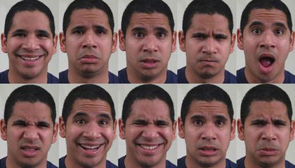
Project Objective
For years, scientists studying facial expressions have focused their research on six primary emotions: happiness, surprise, anger, sadness, fear, and disgust.
As a result generations of facial-expression research papers have included panels that look something like this:

Slide 3
Methodology
Dataset Collection:
We will collect dataset from google and we will experiment our CNN model on those datasets. Example:
The AR Face Database, The Ohio State University
AT & T - The Database of Faces
The Basel Face Model (BFM)
Caltech Faces
Model Selection:
Basically we will use Convolutional Neural Network(CNN) for building our model

Slide 4
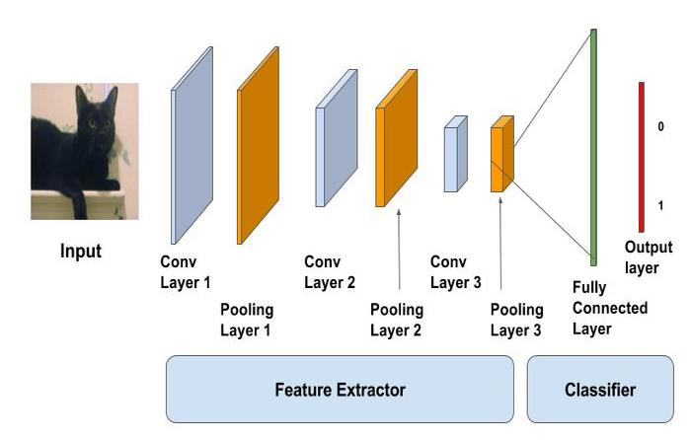
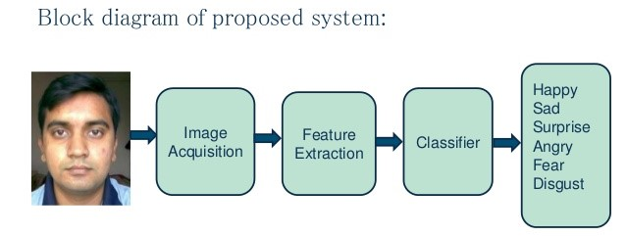
Model Selection:
Basically we will use Convolutional Neural Network(CNN) for building our model. We may use ResNet-50, Resnet-101,VGG12,AlexNet etc which are variation of CNN deep learning Algorithm.

Slide 5
Mode Training And Testing:
We will take 80% data for training our model and for testing we will take 20% data.
We will trail our model with full dataset if we will manage proper resources to train our CNN model.
We will also use Computer Vision for real time frame capturing.

Slide 6
Tools we will use:
Python
Keras (backend tensorflow)
Open Cv

Slide 7
Conclusion:
We will use above methodology in our project and if we did not get enough accuracy then we will change our model and datasets for more accurate output.

